Slide 1
Epidemiological study for Prince George’s County
By: Eddie and Xander

Slide 2
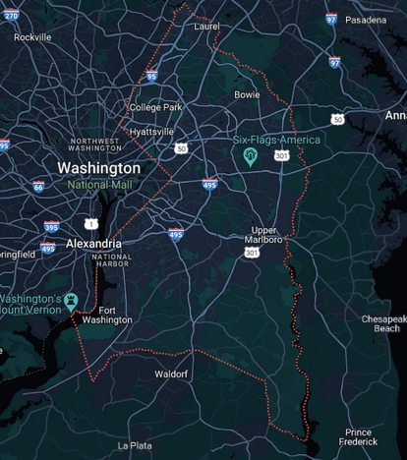
Description
Studying the effects of COVID-19 in Prince George’s County and the District of Columbia. (Validation)
PG County is a smaller section right outside the mall.
We modelled the infections and deaths using SIR and SEIR models.
This included optimizing over the following variables:
Alpha (α) – $\frac{1}{\text{α}}$ represents the infection period of an individual. (in days)
Beta (β) – represents how many people an infected person contacts daily.
R₀ – represents how many people, on average, an infected person contacts over their infectious period.
Gamma (γ) – represents the fatality percent.
Rho (ρ) – represents the infection undercounting number.

Slide 3
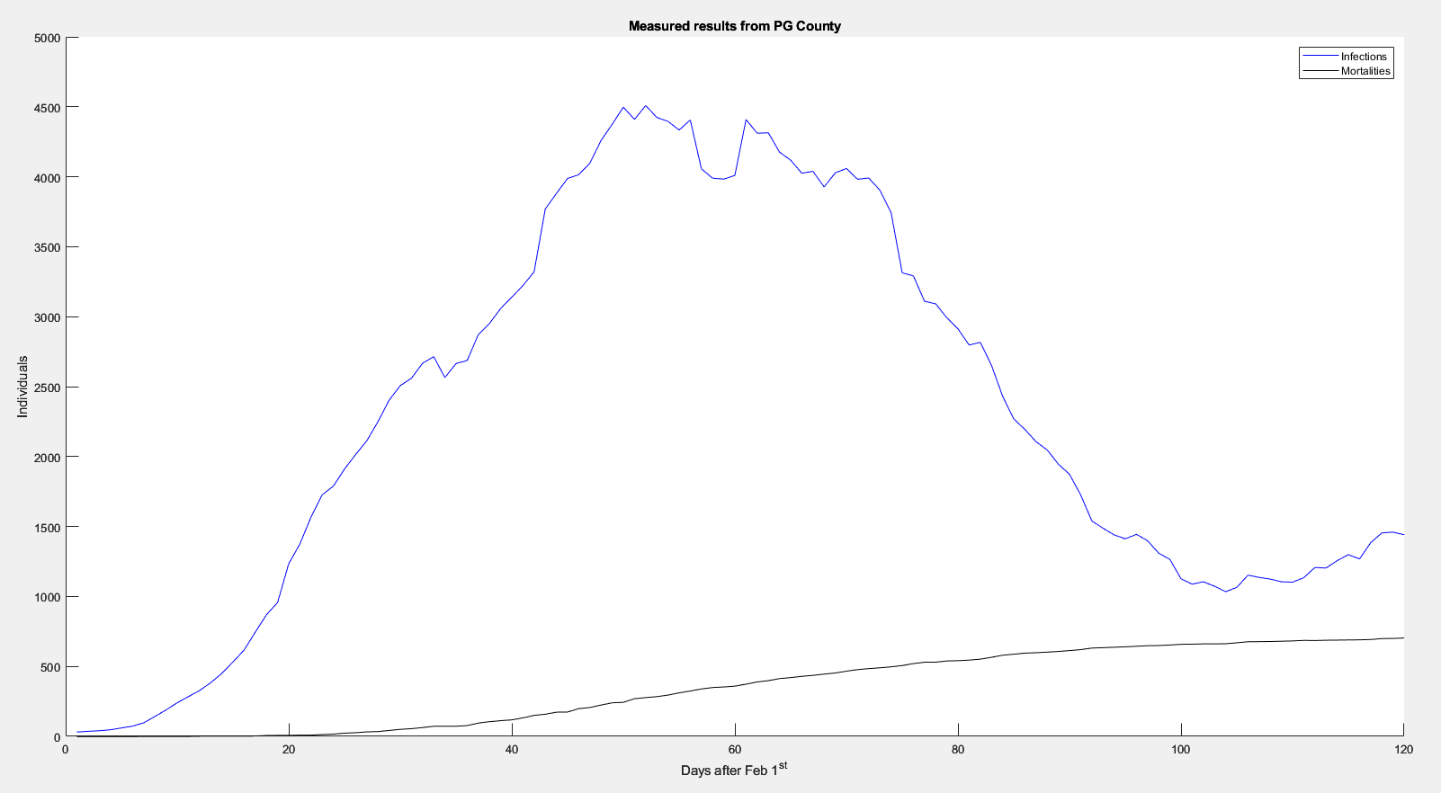

Slide 4
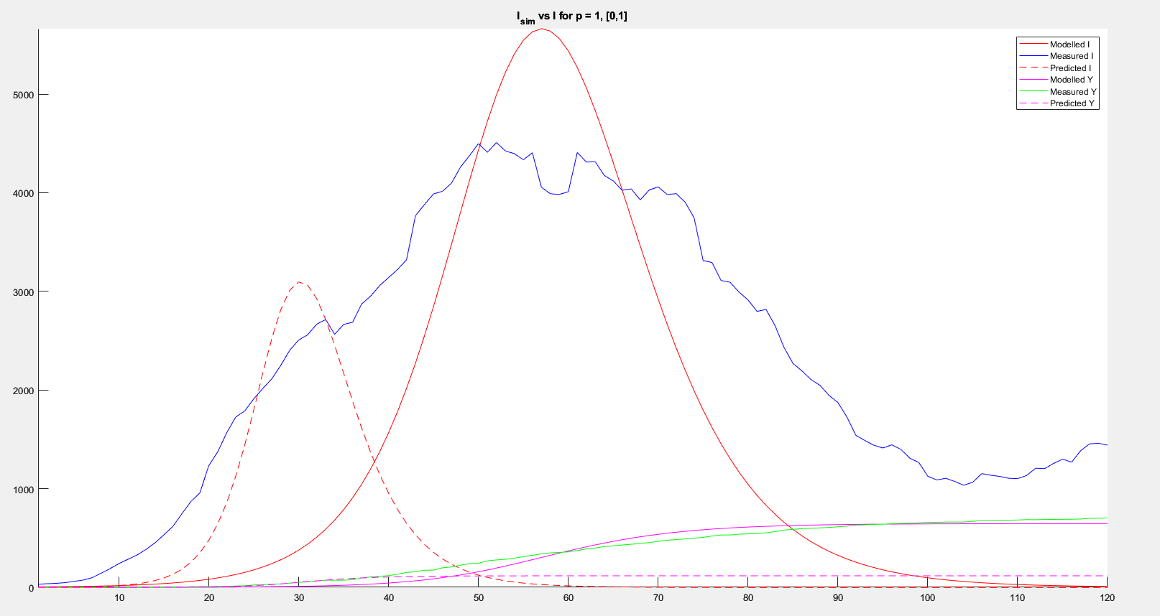
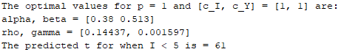
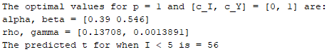
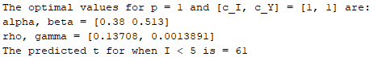
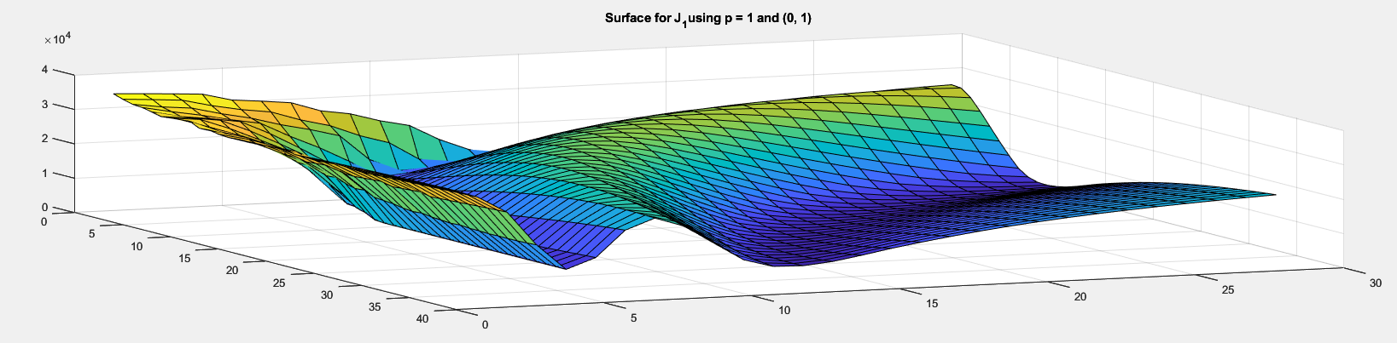
SIR Results (p = 1)
Optimal J value: 4661.26
[c_{I}, c_{Y}] = [0, 1]
α – 0.39
β – 0.546
R₀ – 0.71
ρ – 0.13708
γ – 0.0013891 (!)

Slide 6
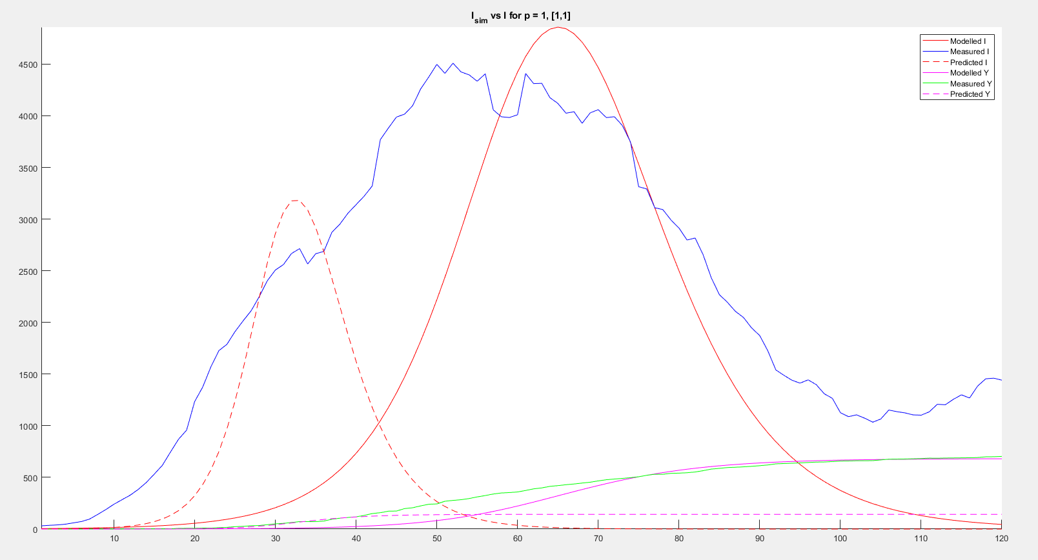
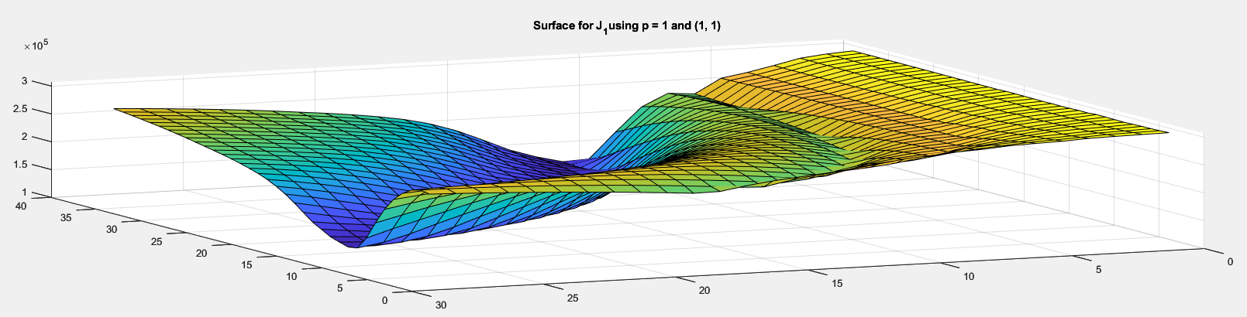
SIR Results (p = 1)
Optimal J value: 132302.20
[c_{I}, c_{Y}] = [1, 1]
α – 0.38
β – 0.513
R₀ – 0.74
ρ – 0.14437
γ – 0.001597 (!)

Slide 8
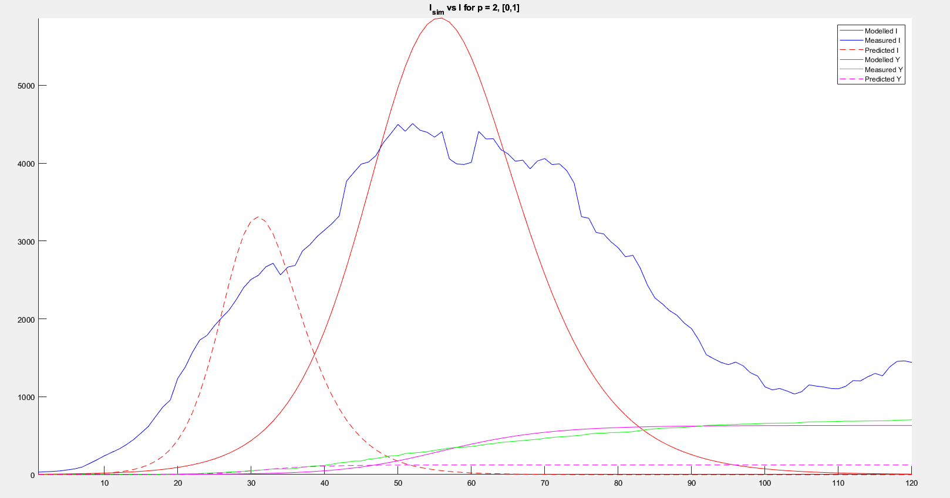
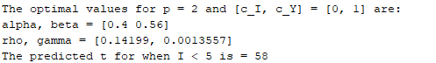
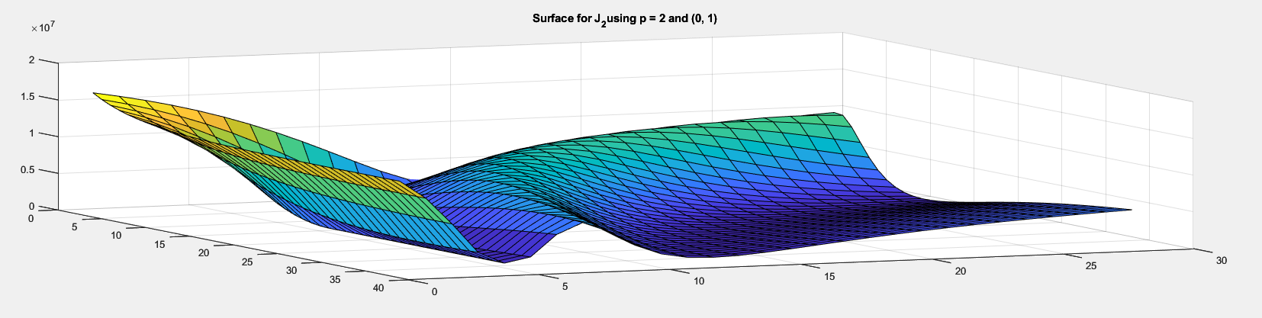
SIR Results (p = 2)
Optimal J value: 281747.38
[c_{I}, c_{Y}] = [0, 1]
α – 0.4
β – 0.56
R₀ – 0.71
ρ – 0.14199
γ – 0.0013557 (!)

Slide 9
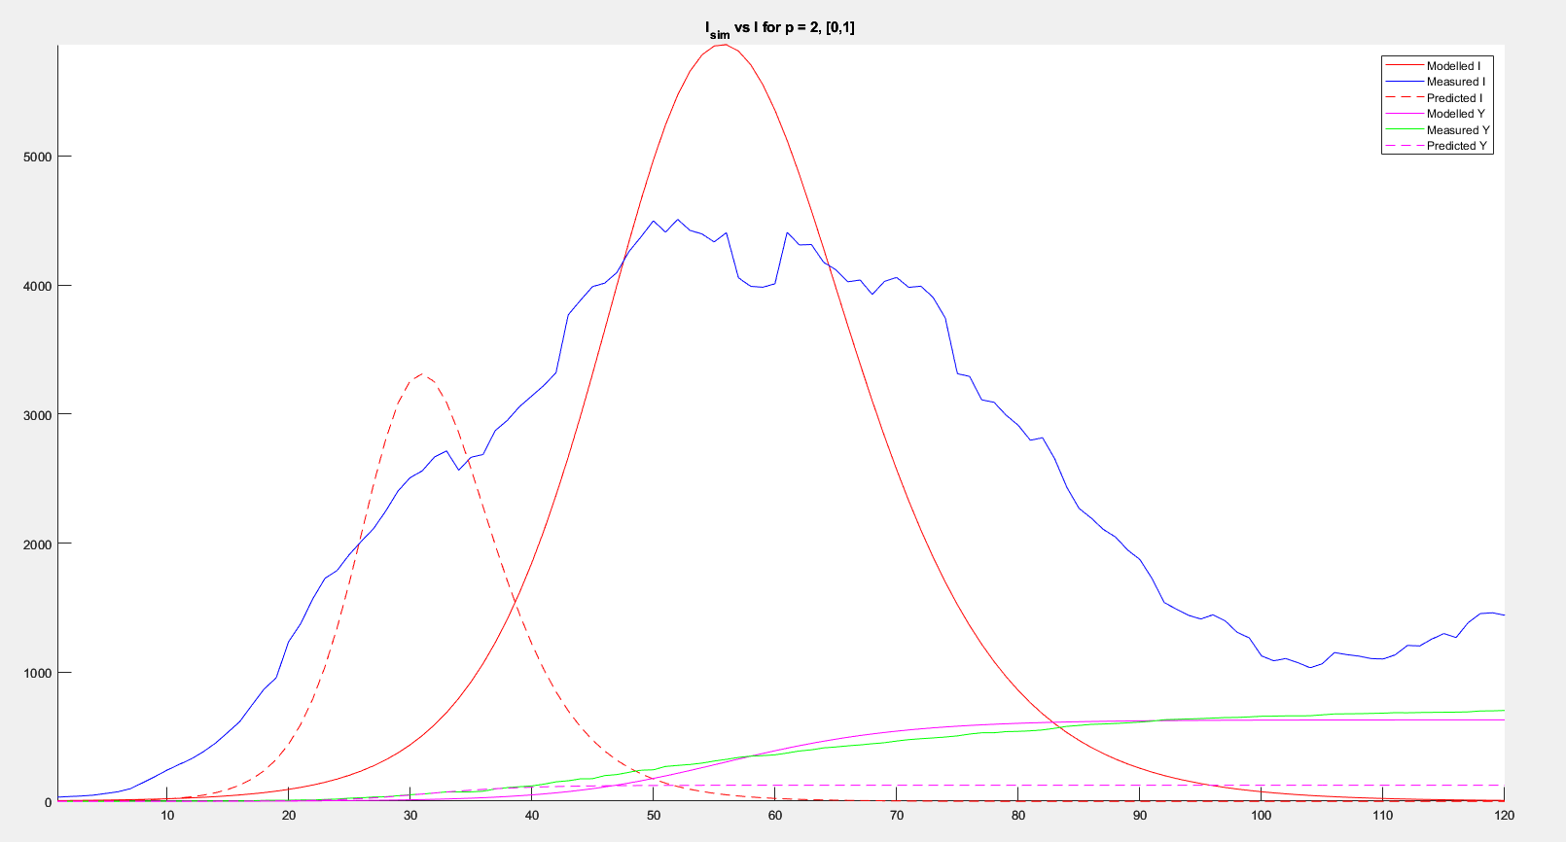

Slide 10
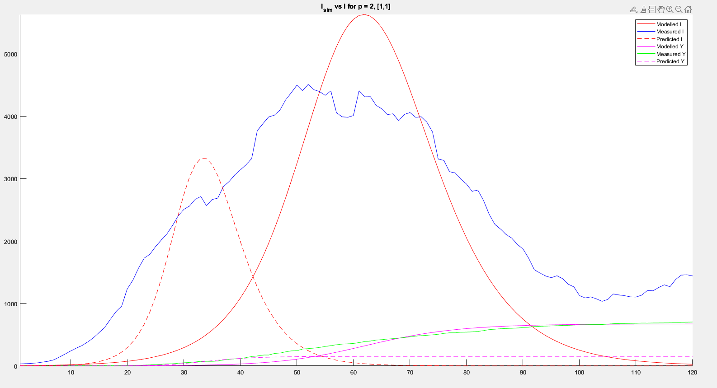
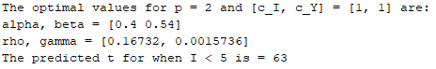
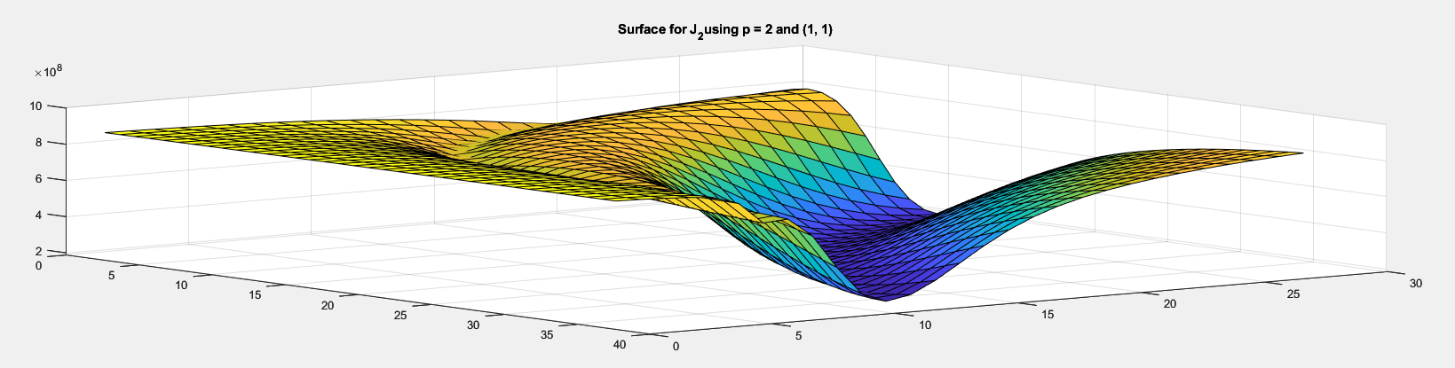
SIR Results (p = 2)
Optimal J value: 187335583.33
[c_{I}, c_{Y}] = [1, 1]
α – 0.4
β – 0.54
R₀ – 0.74
ρ – 0.16732
γ – 0.0015736 (!)

Slide 12
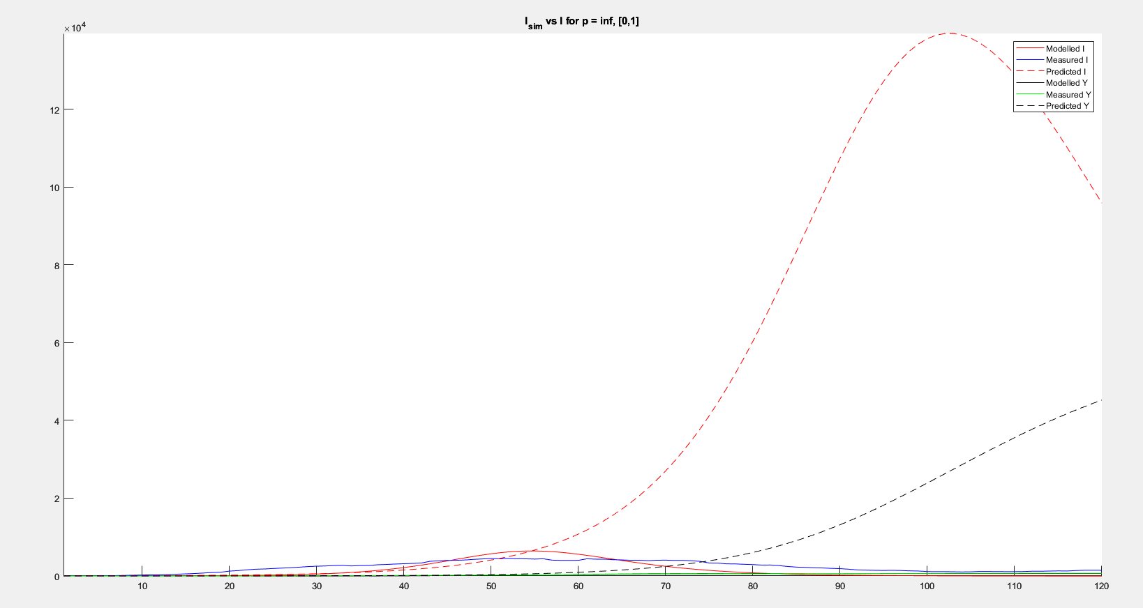
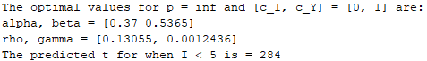
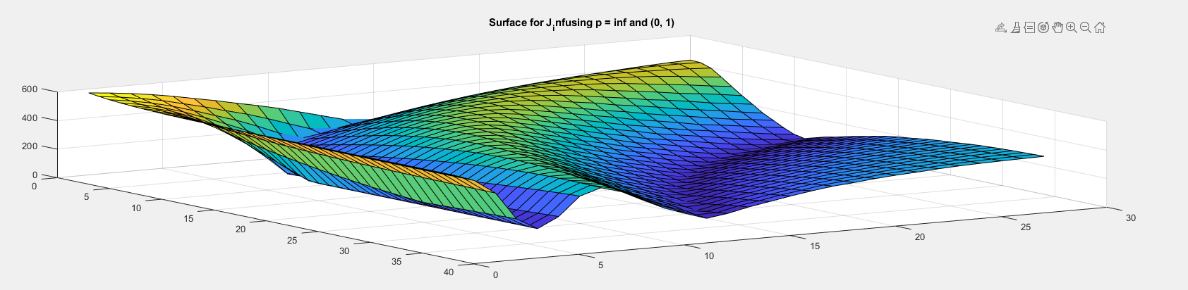
SIR Results (p = ∞)
Optimal J value: 83.202 (!)
[c_{I}, c_{Y}] = [0, 1]
α – 0.37
β – 0.5365
R₀ – 0.689
ρ – 0.13055
γ – 0.0012436

Slide 13
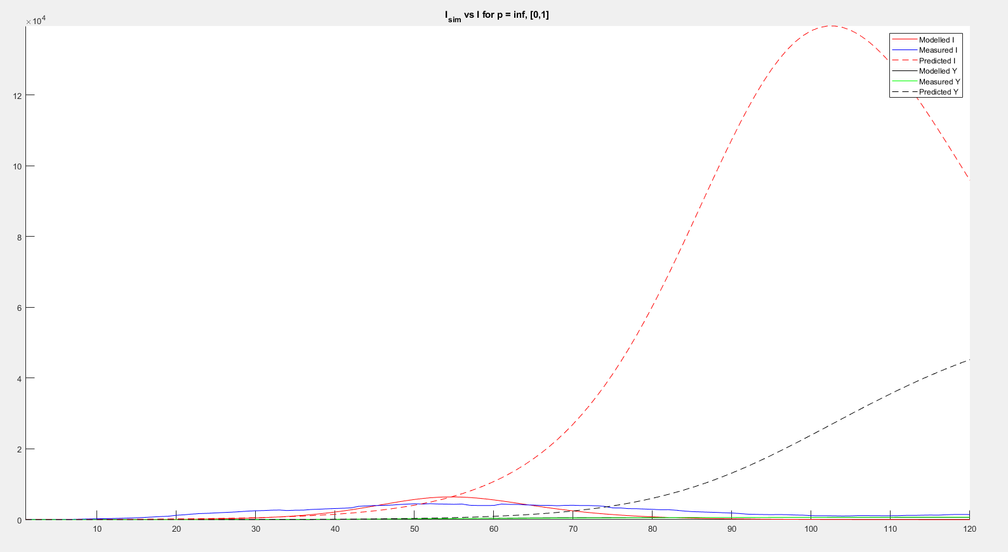
ρ_{pred} = 1
γ_{pred} = 0.0853

Slide 14
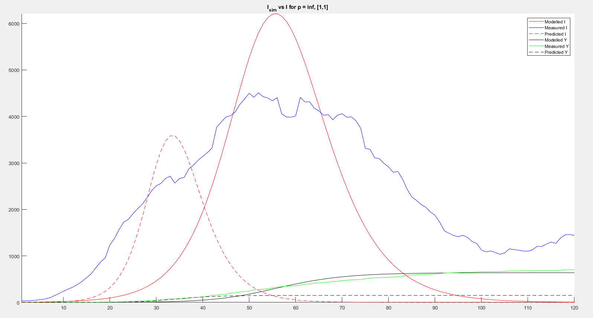
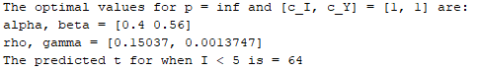
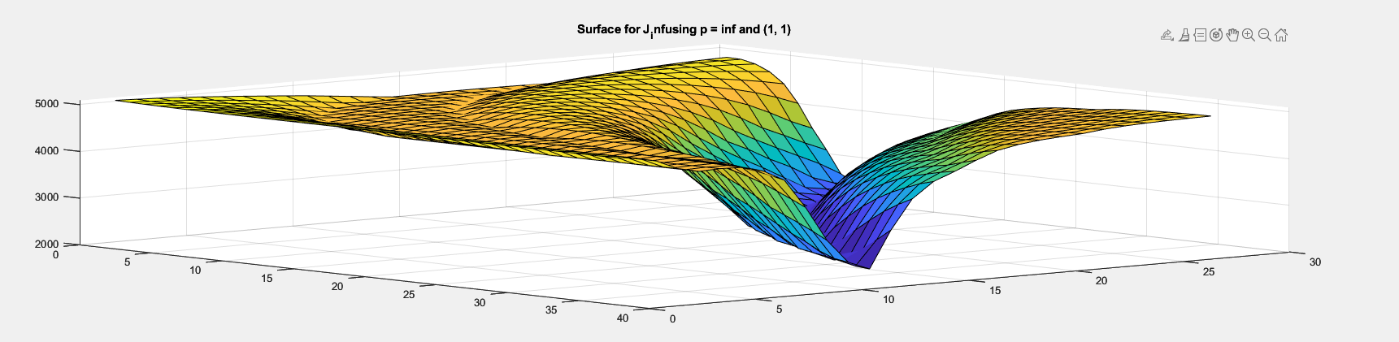
SIR Results (p = ∞)
Optimal J value: 2187.22
[c_{I}, c_{Y}] = [1, 1]
α – 0.4
β – 0.56
R₀ – 0.71
ρ – 0.15037
γ – 0.0013747

Slide 15
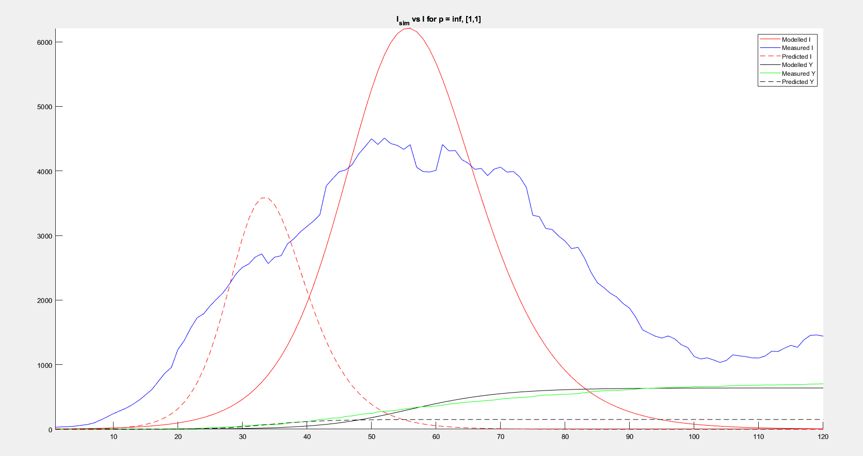

Slide 16
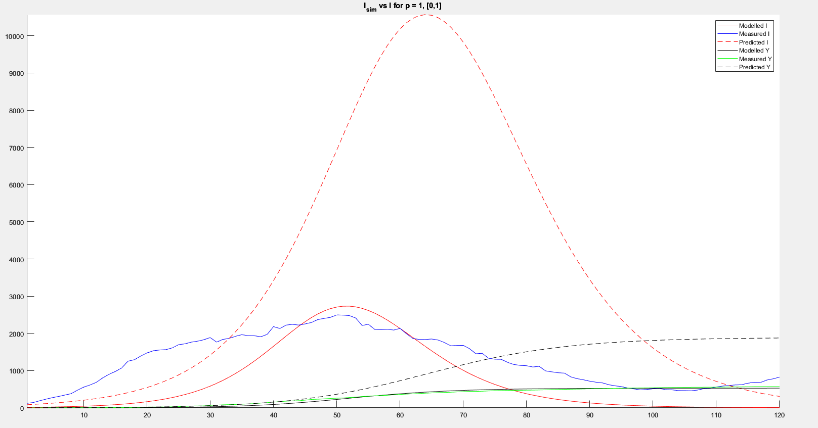
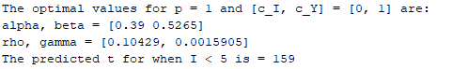
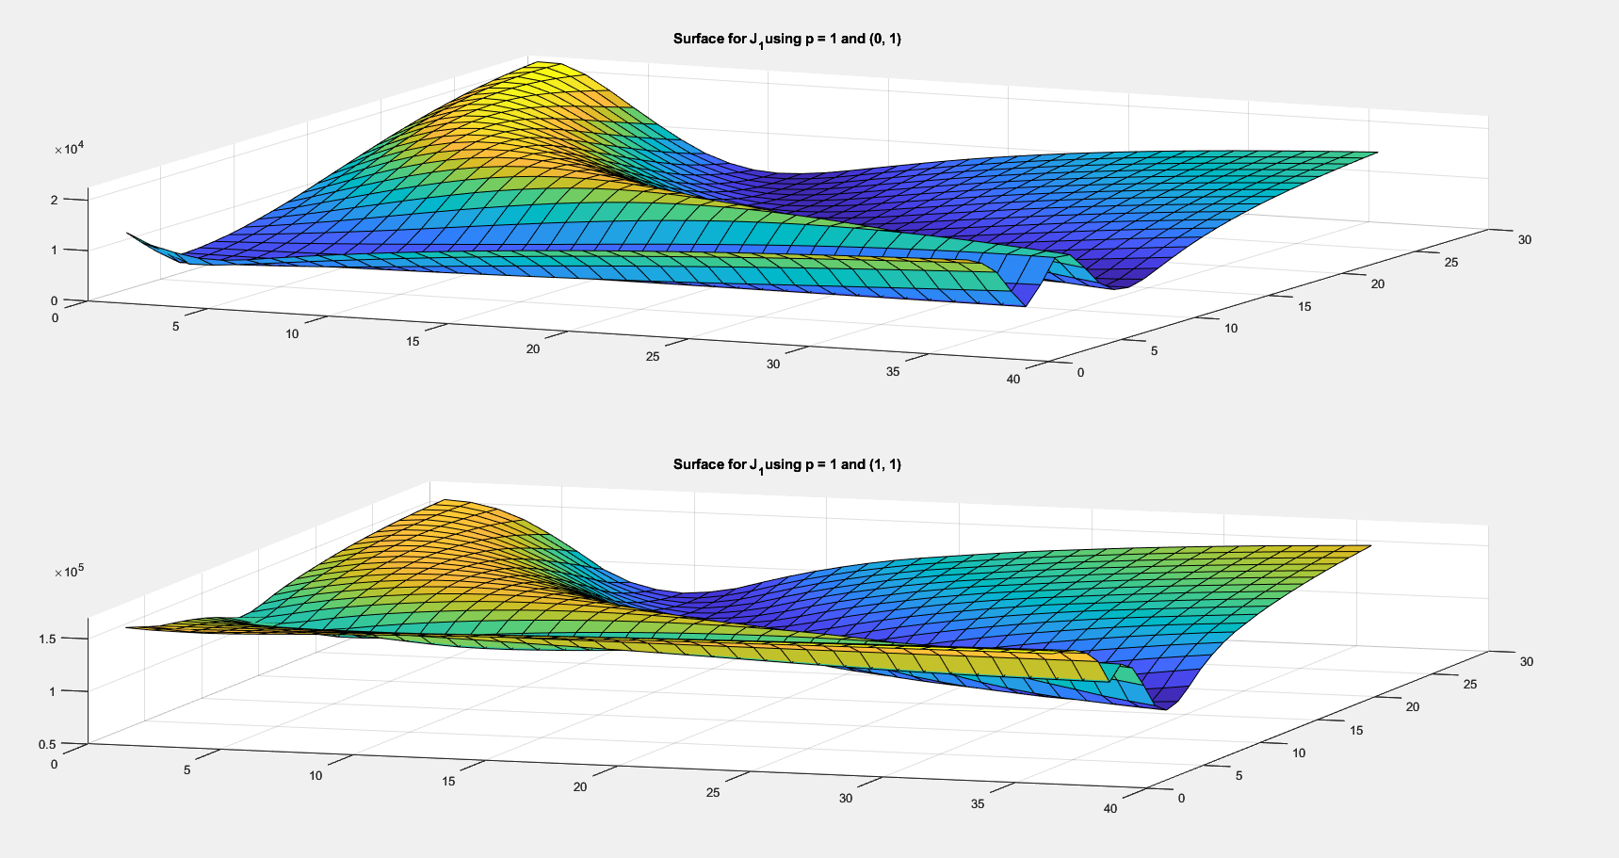
Validation Results (p = 1)
Optimal J value: 3006.96
[c_{I}, c_{Y}] = [0, 1]
α – 0.39
β – 0.5265
R₀ – 0.74
ρ – 0.1042
γ – 0.0015905

Slide 17
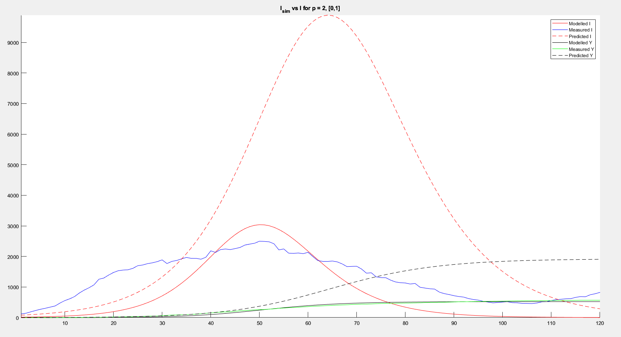
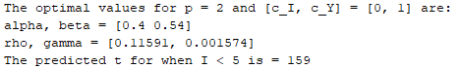
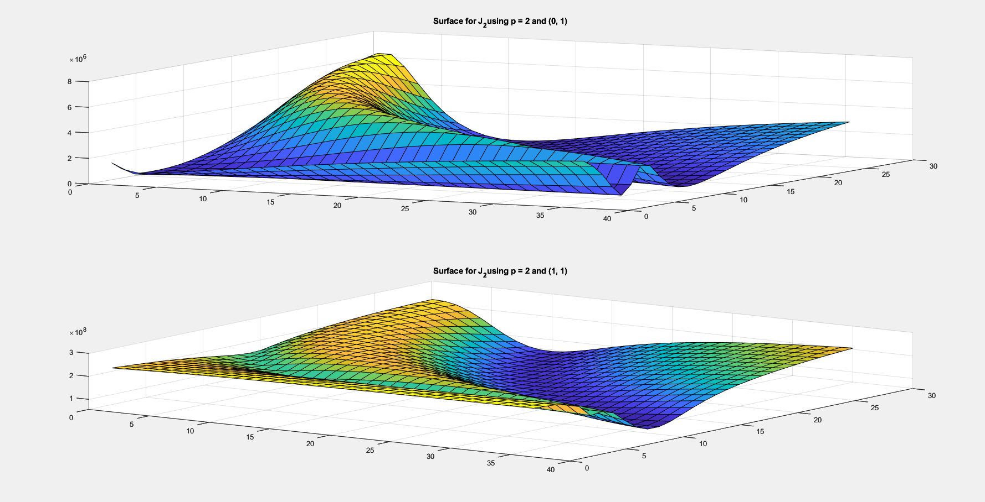
Validation Results (p = 2)
Optimal J value: 107823.59
[c_{I}, c_{Y}] = [0, 1]
α – 0.4
β – 0.54
R₀ – 0.74
ρ – 0.11591
γ – 0.001574

Slide 18
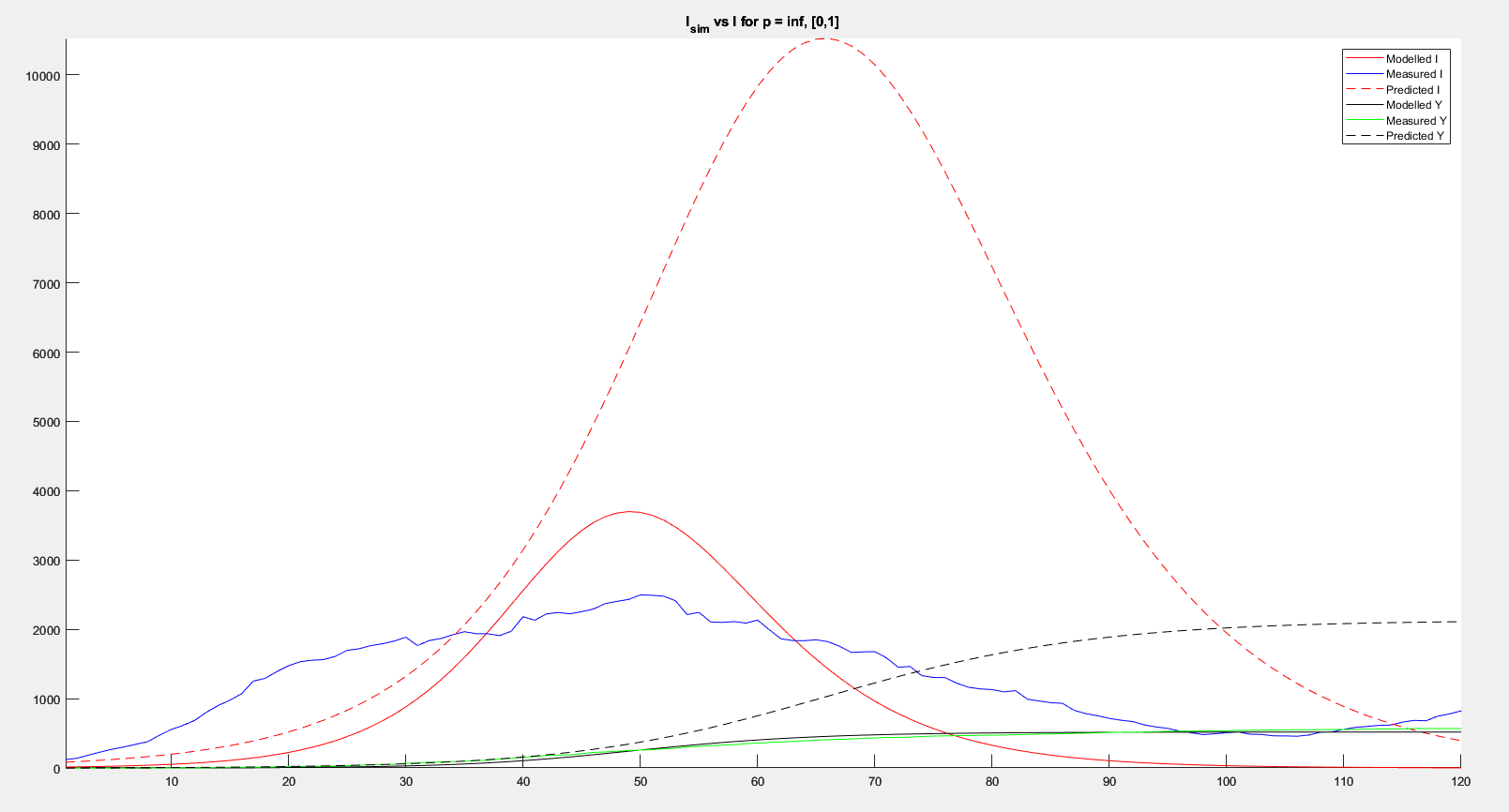
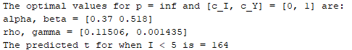
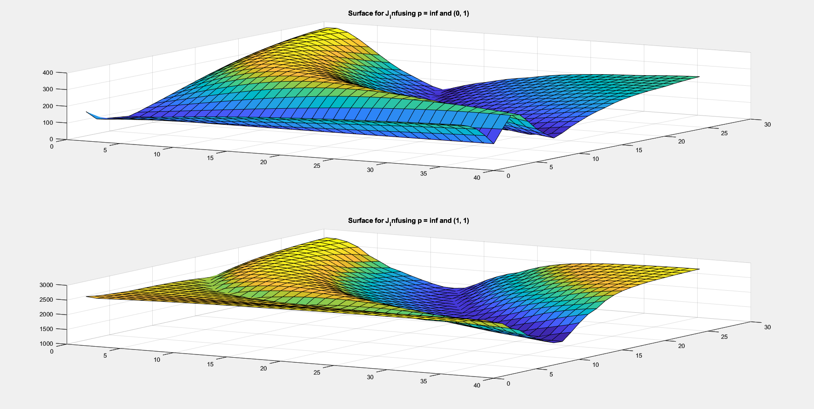
Validation Results (p = ∞)
Optimal J value: 50.03 (!)
[c_{I}, c_{Y}] = [0, 1]
α – 0.37
β – 0.518
R₀ – 0.71
ρ – 0.11506
γ – 0.001435

Slide 19
Important Points
Relatively low mortality rate (γ)
Always around 0.0013
About double COVID-19’s measured mortality rate
Similar α, β, and R₀ values as well.
Important days:
t = 55: March 17th, around when lockdown begins; UMD closes soon.
t = 70: April 1st, lockdown in full swing.
t = 100: May 1st, suspicion begins, and people start breaking lockdown.

Slide 20
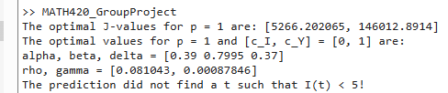
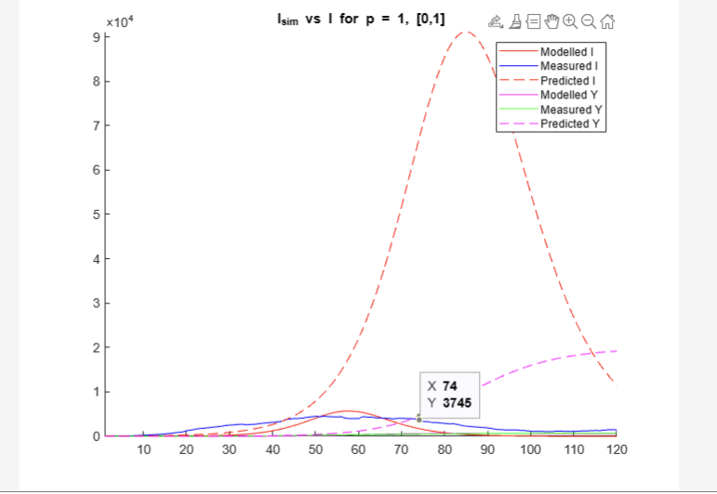
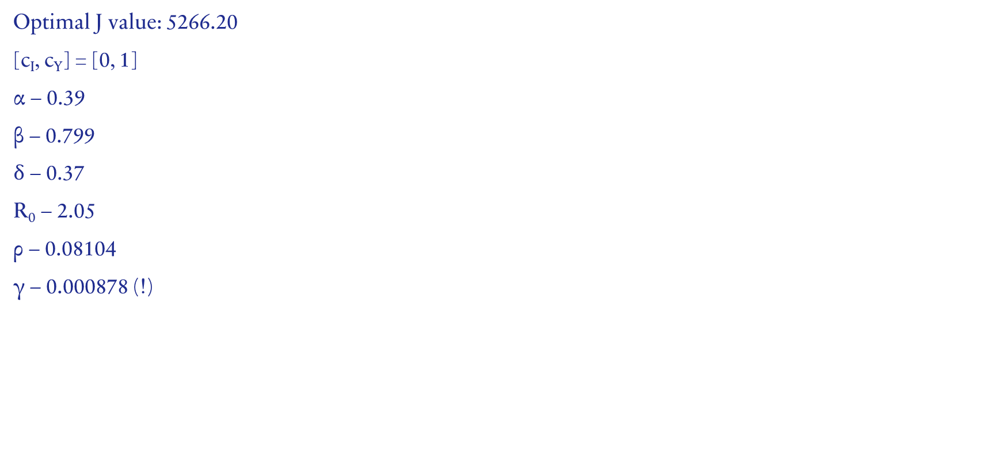
SEIR Results (p = 1)
Optimal J value: 5266.20
[c_{I}, c_{Y}] = [0, 1]
α – 0.39
β – 0.799
$δ$ – 0.37
R₀ – 2.05
ρ – 0.08104
γ – 0.000878 (!)

Slide 21
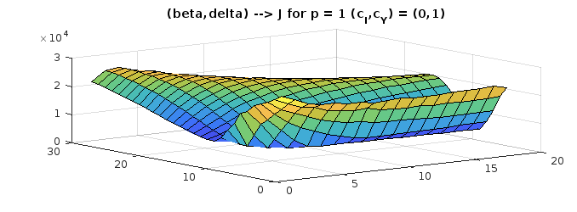
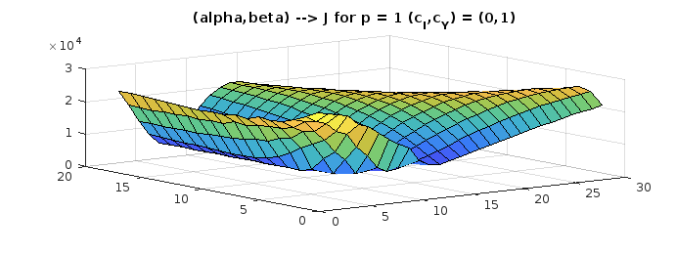
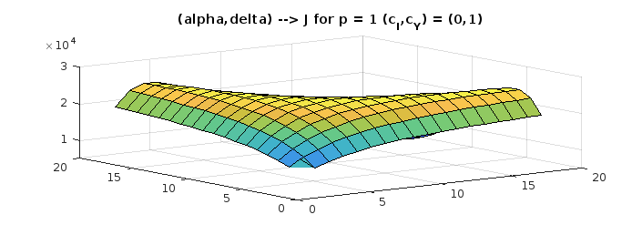
SEIR Results (p = 1)

Slide 22
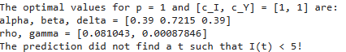
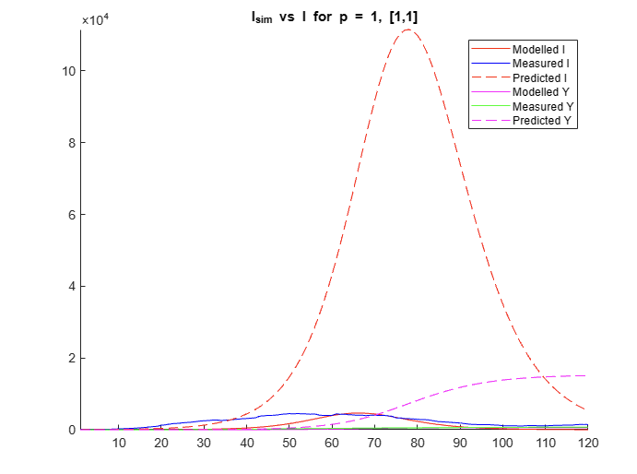
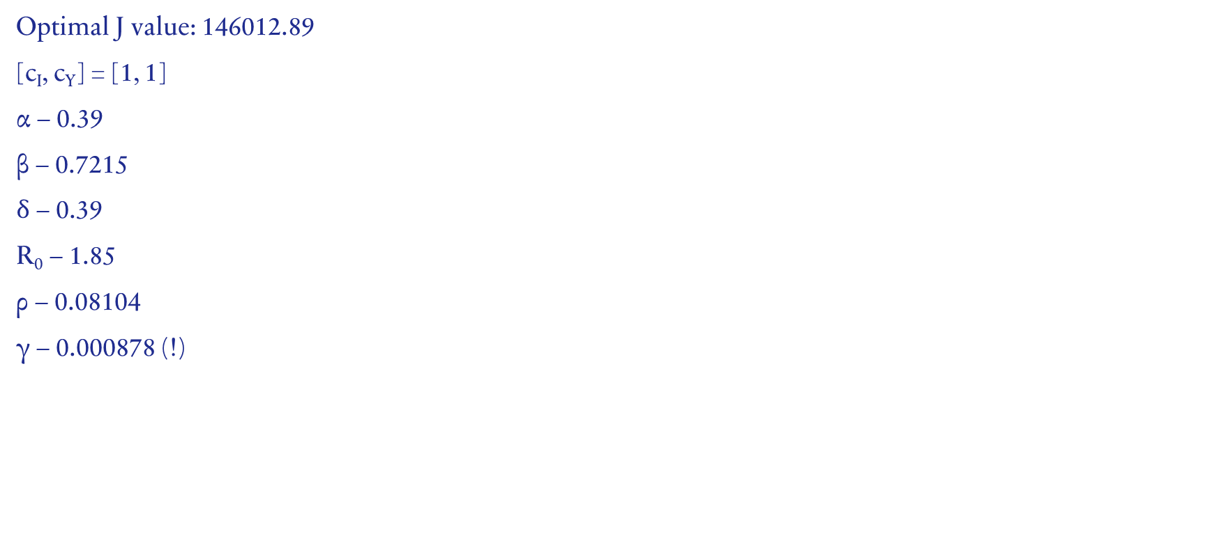
SEIR Results (p = 1)
Optimal J value: 146012.89
[c_{I}, c_{Y}] = [1, 1]
α – 0.39
β – 0.7215
$δ$ – 0.39
R₀ – 1.85
ρ – 0.08104
γ – 0.000878 (!)

Slide 23
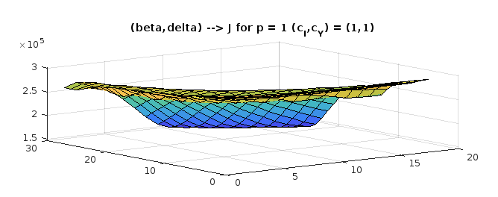
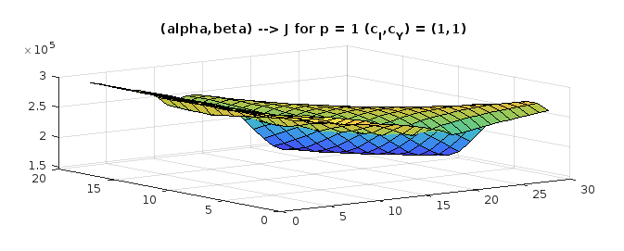
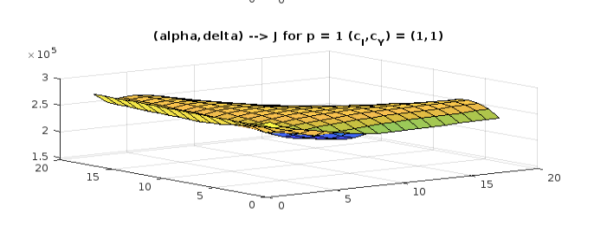
SEIR Results (p = 1)

Slide 24
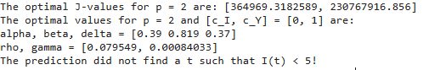
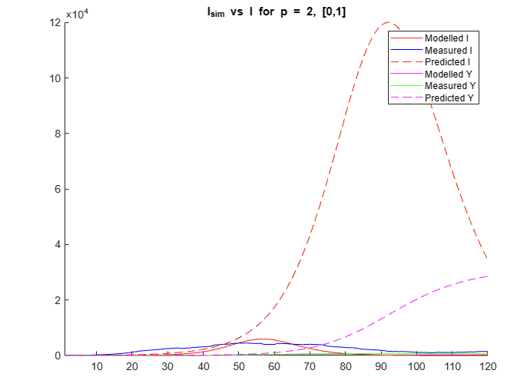

SEIR Results (p = 2)
Optimal J value: 364969.32
[c_{I}, c_{Y}] = [0, 1]
α – 0.39
β – 0.819
$δ$ – 0.37
R₀ – 2.1
ρ – 0.07955
γ – 0.0008403 (!)

Slide 25
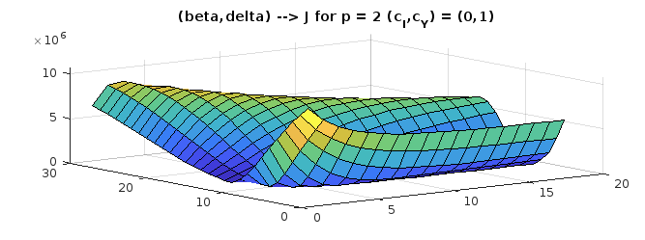
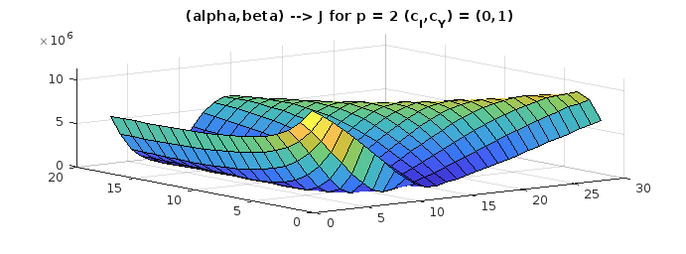
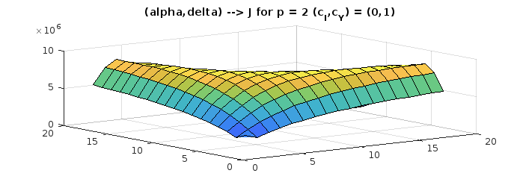
SEIR Results (p = 2)

Slide 26



SEIR Results (p = 2)
Optimal J value: 230767916.86
[c_{I}, c_{Y}] = [1, 1]
α – 0.39
β – 0.7605
$δ$ – 0.39
R₀ – 1.95
ρ – 0.07955
γ – 0.0008403 (!)

Slide 27



SEIR Results (p = 2)

Slide 28



SEIR Results (p = inf)
Optimal J value: 94.414
[c_{I}, c_{Y}] = [0, 1]
α – 0.37
β – 0.814
$δ$ – 0.37
R₀ – 2.2
ρ – 0.08013
γ – 0.0007976 (!)

Slide 29



SEIR Results (p = inf)

Slide 30



SEIR Results (p = inf)
Optimal J value: 2364.729
[c_{I}, c_{Y}] = [1, 1]
α – 0.39
β – 0.819
$δ$ – 0.37
R₀ – 2.1
ρ – 0.08013
γ – 0.0007976 (!)

Slide 31



SEIR Results (p = inf)

Slide 32



(VALIDATION) SEIR (p = 1)
Optimal J value: 3655.403
[c_{I}, c_{Y}] = [0, 1]
α – 0.39
β – 0.741
$δ$ – 0.39
R₀ – 1.9
ρ – 0.059178
γ – 0.0009694 (!)

Slide 33



(VALIDATION) SEIR (p = 1)
Optimal J value: 83136.600
[c_{I}, c_{Y}] = [1, 1]
α – 0.39
β – 0.7215
$δ$ – 0.39
R₀ – 1.85
ρ – 0.059178
γ – 0.0009694 (!)

Slide 34



(VALIDATION) SEIR Results (p = 1)

Slide 35



(VALIDATION) SEIR (p = 2)
Optimal J value: 160787.735
[c_{I}, c_{Y}] = [0, 1]
α – 0.39
β – 0.7605
$δ$ – 0.39
R₀ – 1.95
ρ – 0.06121
γ – 0.00093485 (!)

Slide 36



(VALIDATION) SEIR (p = 2)
Optimal J value: 69804282.17
[c_{I}, c_{Y}] = [1, 1]
α – 0.39
β – 0.741
$δ$ – 0.39
R₀ – 1.90
ρ – 0.06121
γ – 0.00093485 (!)

Slide 37



(VALIDATION) SEIR Results (p = 2)

Slide 38



(VALIDATION) SEIR (p = inf)
Optimal J value: 60.73
[c_{I}, c_{Y}] = [0, 1]
α – 0.39
β – 0.780
$δ$ – 0.39
R₀ – 2.00
ρ – 0.070506
γ – 0.00090135 (!)

Slide 39



(VALIDATION) SEIR (p = inf)
Optimal J value: 1415.46
[c_{I}, c_{Y}] = [1, 1]
α – 0.39
β – 0.819
$δ$ – 0.39
R₀ – 2.10
ρ – 0.070506
γ – 0.00090135 (!)

Slide 40



(VALIDATION) SEIR Results (p = inf)

Slide 41

SEIR Important Points
Still a low mortality rate (γ) in SEIR
Never above 0.001
About double COVID-19’s measured mortality rate
Optimal α , β, $δ$ values lie near respective upper bounds (0.40, 2.2, 0.40)
β → # of close contacts per day
α → inversely prop to average infectious period
$δ$ → inversely prop to incubation period
40-day model failed to make accurate predictions in most cases

Slide 42

SEIR Trained on 60-day timeframe

